Slide 1
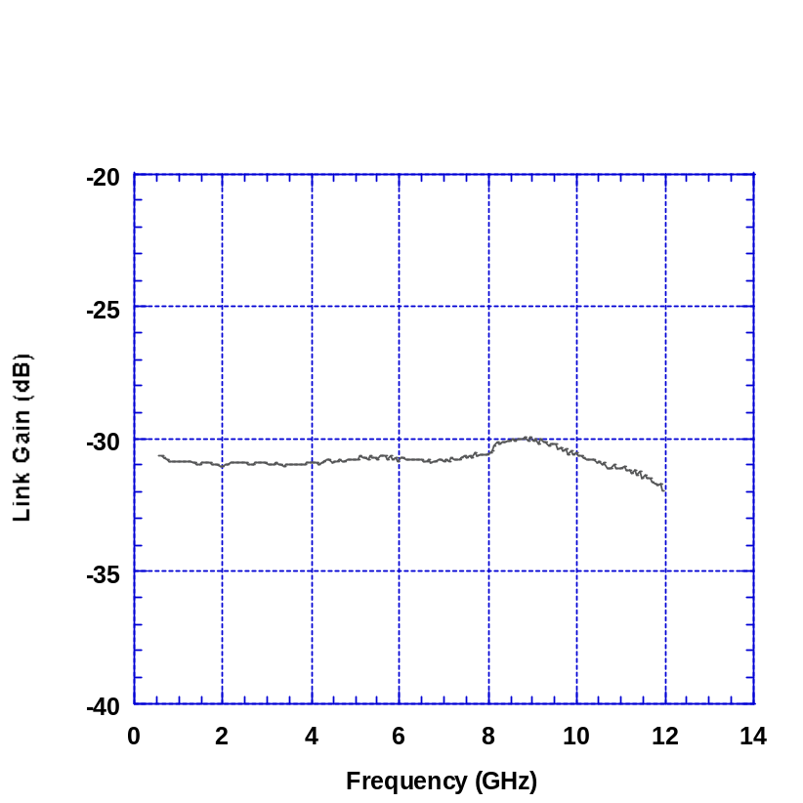
NEC 0228Q002
004
Discovery 500372
EAM004
23-Oct 2002
HVR
1.054
2.817
-.703
67.25
1.2054
. 00772
1547.0

Slide 2
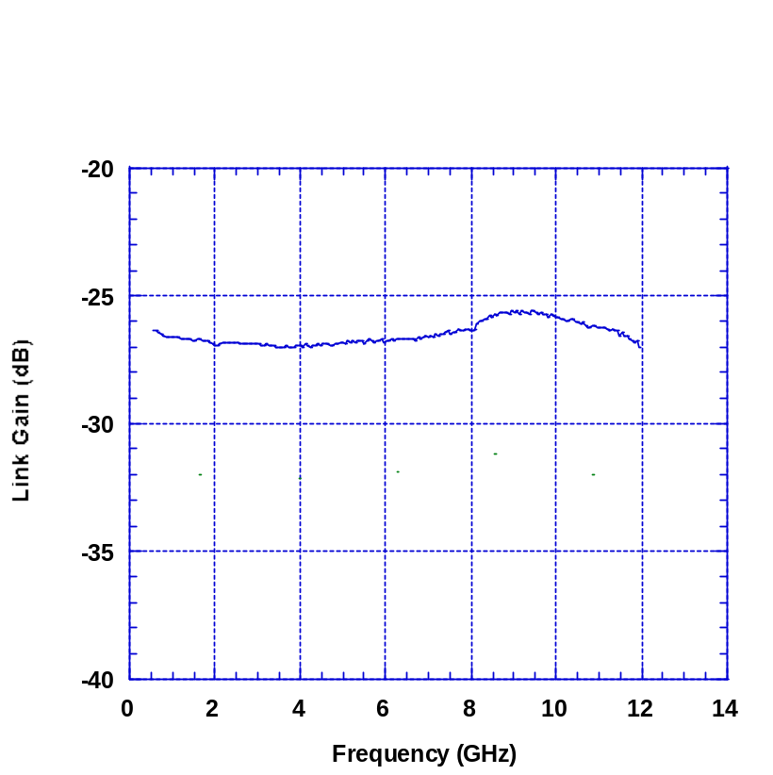
NEC 0228Q005
005
Discovery 500373
EAM005
23-Oct 2002
HVR
0.967
2.725
-0.737
76.14
2.9
. 00756
1558.8

Slide 3
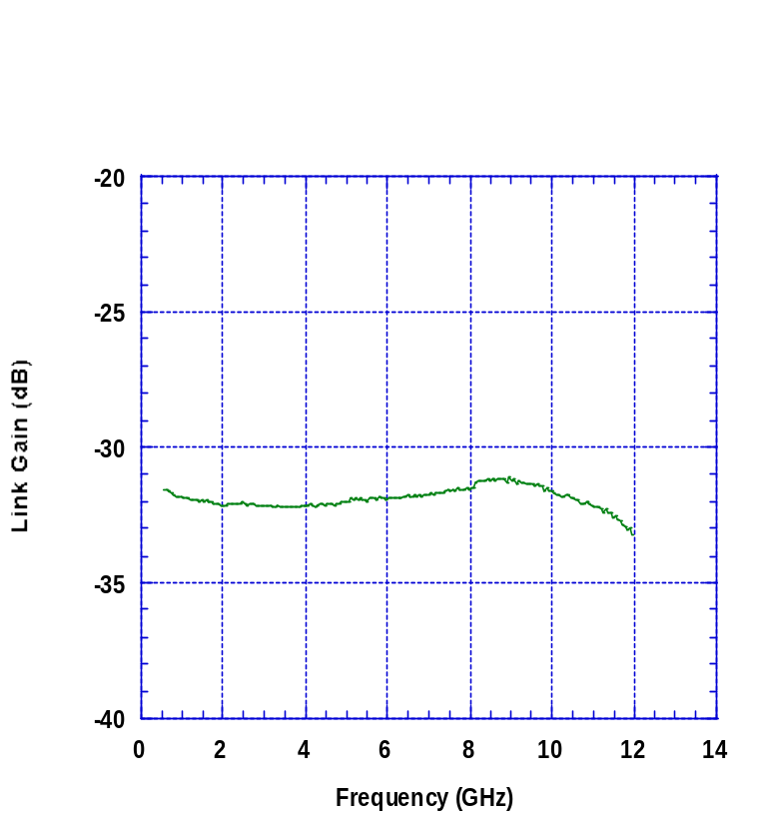
NEC 0228Q014
002
Discovery 500378
EAM002
23-Oct 2002
HVR
1.055
2.828
-0.55
77.27
-1.1406
0.0137
1547.0

Slide 4
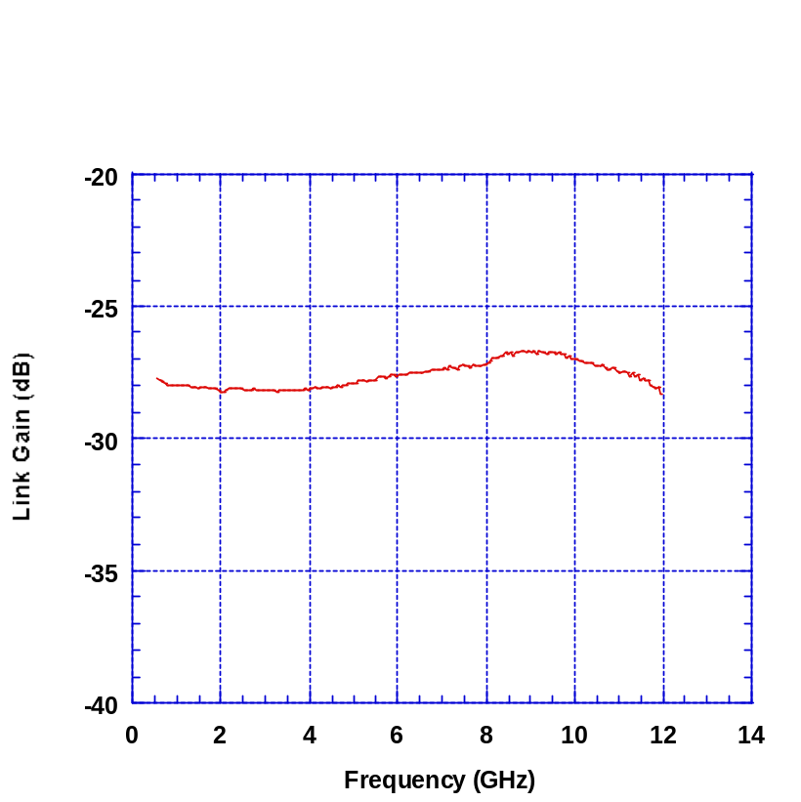
NEC 0228Q003
003
Discovery 500379
EAM003
24-Oct 2002
HVR
2.111
4.17
-0.713
77.73
1549.3
0.0116
1547

Slide 5
HVR

